Slide 1
Damp and Mould Checklist
On behalf of Bristol One City Damp and Mould group

Slide 2
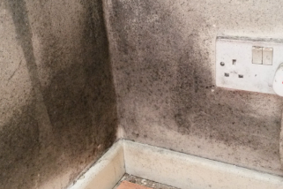
Background
In December 2020, 2-year-old Awaab Ishak died from a severe respiratory infection caused by prolonged exposure to damp and mould in his home.
It is estimated that over 962,000 households in England have damp and mould in their home.
Emerging legislation: Awaab’s Law and Renters’
Rights Bill.
New “Understanding and addressing the health
risks of damp and mould in the home” guidance.

Slide 3
The impacts of damp and mould
Listen to Kadra and Wendy’s experience of raising their children and managing their lives in damp homes.
“I feel stressed in this house”

Slide 4
One City approach
One City goal:
There are clear plans to tackle issues of damp, mould, and fire safety in Bristol’s housing which will include continuing work on fire safety in high rise accommodation.
One City Homes and Communities Board initiated a damp and mould task and finish group including partners across the city.
Interviews conducted with stakeholders across the system to understand challenges (March 2024).

Slide 5
Interview findings
Health professionals in Bristol reported:
Seeing an increase in residents unable to heat homes and reporting damp and mould,
Frequently being asked to provide letters highlighting impact of housing on health – but don’t know what should say, where these should go or if should be sending a letter,
Don’t know where to refer and signpost and often see
patients from different local authorities.

Slide 6
Example from other areas: London Damp and Mould Checklist
Identifying housing concerns
What to look for / ask
Assessing clinical vulnerability
Taking action
Where to signpost and refer
Template letters to send to housing providers
Notes:
London checklist was used as a starting point and adapted based on input from health and care staff

Slide 7
Bristol Damp and Mould Checklist
Who is it for?
All health and care staff in Bristol, North Somerset or South Gloucestershire.
Who developed it?
Bristol One City Damp and Mould group which includes various partners, including: NHS, Social Care, Centre for Sustainable Energy, Housing Matters, Bristol Health Partners, Social Housing Providers and Private Sector Housing.
What does it aim to do?
Support health and care staff to identify and respond to concerns relating to damp and mould and fuel poverty,
Increase referrals into fuel poverty advice.
Notes:
Aim – Also to have a consistent approach

Slide 8
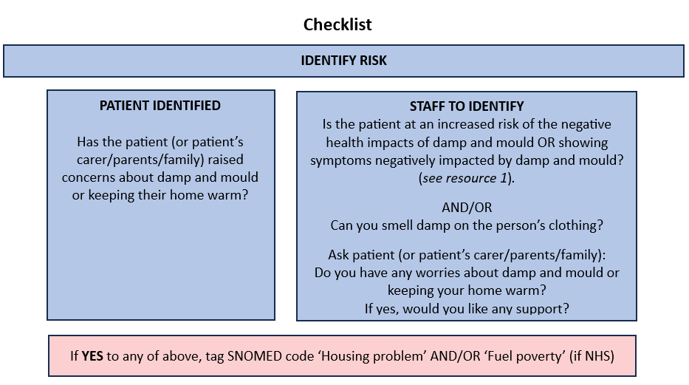
Checklist: IDENTIFY
The checklist provides guidance on actions to take including advice, signposting, and template letters to raise housing concerns.

Slide 9
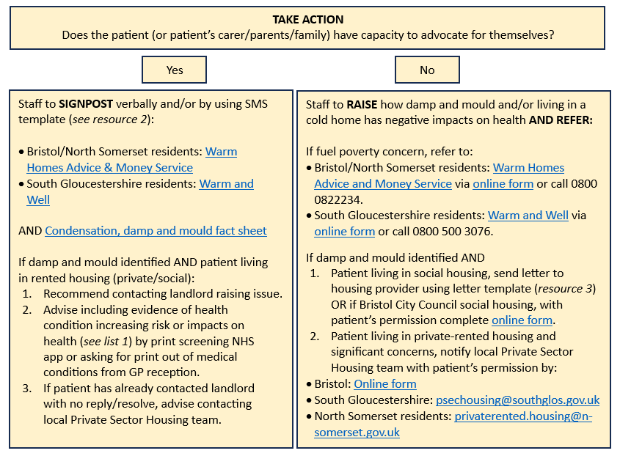
Checklist: TAKE ACTION

Slide 10
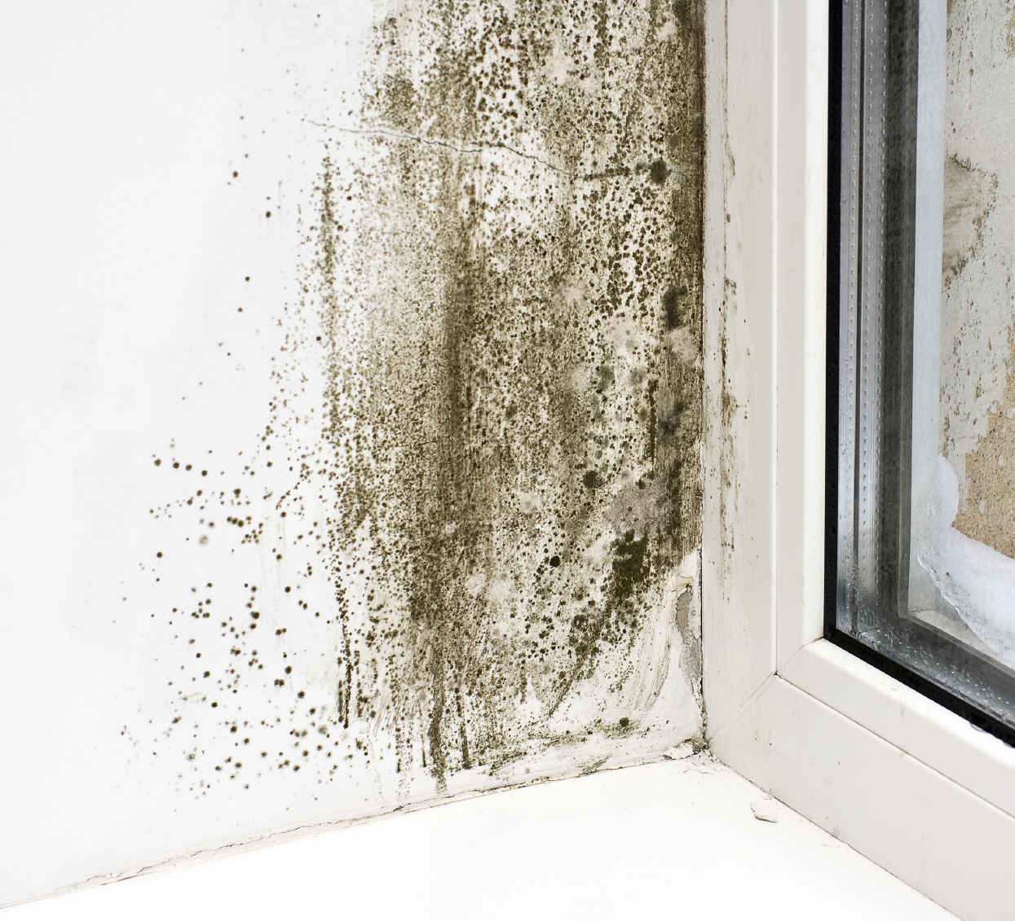
Additional resources
List of population groups and health conditions which increase a person’s risk of the negative health impacts of damp and mould,
SMS signposting template,
Letter template to raise housing concerns identified for a tenant (social/private).

Slide 11
Next steps - Pilot
Checklist available from https://www.bristolhealthpartners.org.uk/news/new-tool-for-healthcare-staff-to-support-people-living-in-damp-and-mouldy-homes/
Ask
Raise awareness via your networks and get in touch if any key meetings to attend/promote to,
Any feedback would be greatly appreciated by the 24 February 2025:
Adele Vowles, Senior Public Health Specialist – Healthy People Healthy Places, Bristol City Council: adele.vowles@bristol.gov.uk and
Karen Llewellyn, Senior Project Manager, Bristol Health Partners:
karen.llewellyn@bristol.ac.uk

